Slide 1

Project Team 1 | PID-RP1001
Web - based System for the Prediction of Customer behavior for Insurance companies using DL models
Date: 31-Saturday-2025
Team Members
A. Vijay Kumar
S. Dinesh
M. Yashwanth
Md. Mubashir Ali
B. Ashok
Mentors
Mr. A. Gnanesh Sir
Mr. K. Rajesh Sir

Slide 2
CONTENTS
Title Slide
Introduction
Requirement
Process Flow
Design
Development
Expected Outcome
Thank you!

Slide 3
INTRODUCTION
PROJECT SCOPE
The system is designed to benefit both the insurance company and the customers by:
Providing intelligent insurance recommendations to users based on their personal data.
Helping agents understand customer profiles and risk more effectively.
Enabling data-driven decision making.
Logging and storing activity for further analysis and system improvement.
ABSTRACT
There's a need for an automated, intelligent system to support decision-making.
Manual assessment of customer eligibility is time-consuming and inconsistent.
TARGET TECHNOLOGY DOMAIN
Machine Learning (AI) + Full Stack Web Development + Health Insurance Tech (InsurTech)

Slide 4
REQUIREMENT
STAKE HOLDERS(END USERS)
Customers (Insurance Seekers)
People looking for health insurance policies.
They interact with the system to submit personal and health-related details.
THEIR NEEDS(USE CASES)
Fill out basic health and personal information.
If customer is eligible, then he is able to take the policy.
Easily Register and login to the system.
Agents/Managers (Insurance Providers)
Responsible for reviewing customer data and recommendations.
Access customer predictions and help them choose the right policy.
THEIR NEEDS(USE CASES)
View list of all registered customers.
Get Prediction whether they are “Prominent” or “Not Prominent”.
Access each customer’s prediction result and data.

Slide 5
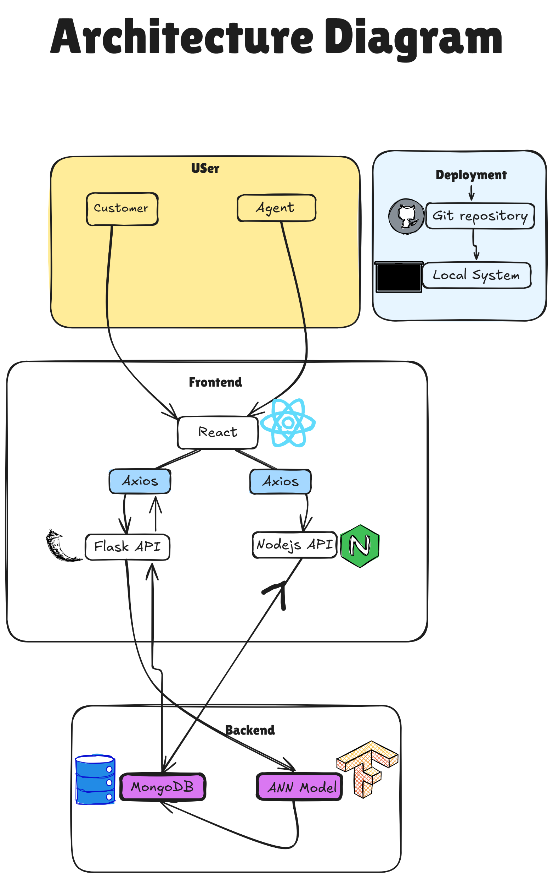
ARCHITECTURE DIAGRAM

Slide 6
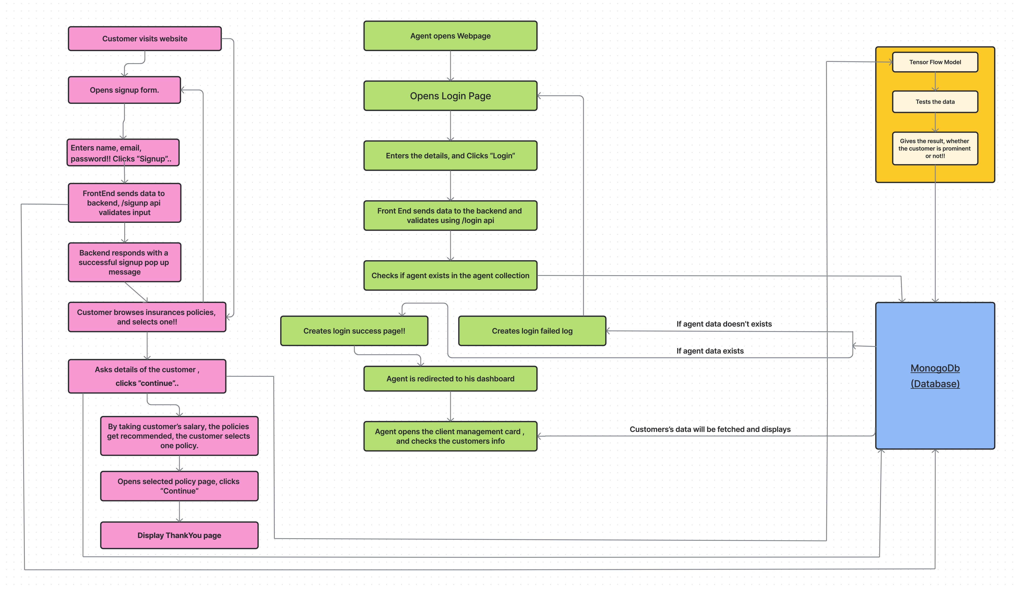
PROCESS FLOW

Slide 7
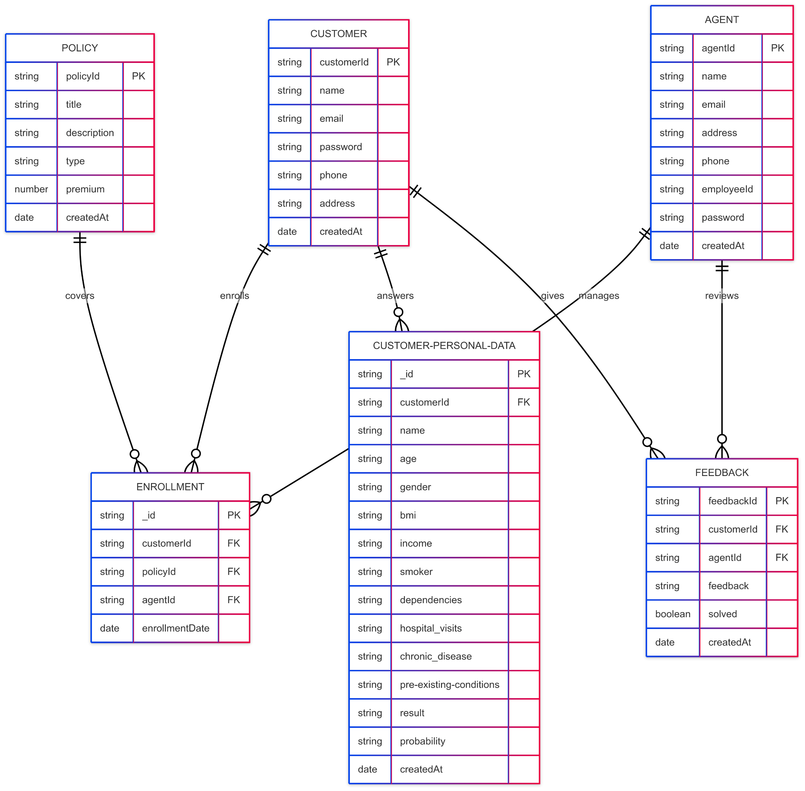
DESIGN
DB DESIGN

Slide 8
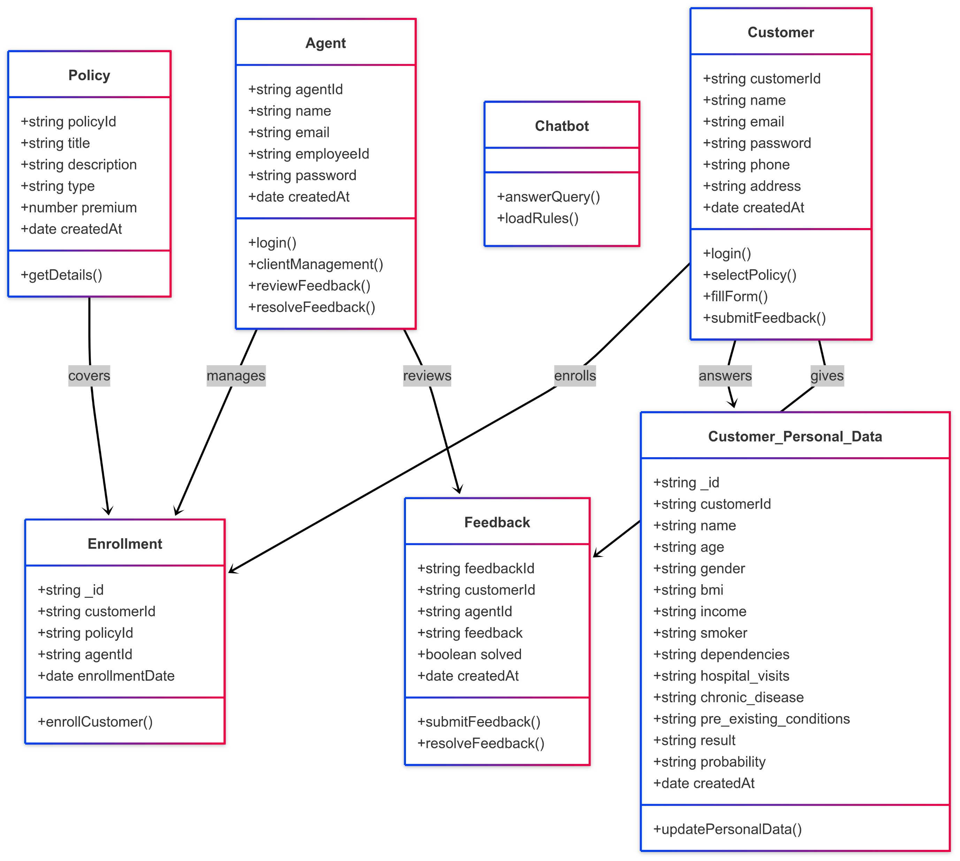
CLASS DIAGRAM

Slide 9
DEVELOPMENT
FEATURES DEVELOPED
Customer and Agent login/signup system
Separate dashboards for Customer and Agent
Customer basic questions form (health-related)
ANN-based prediction model using TensorFlow
IN PROGRESS
Graphical analysis (charts for agent dashboard)
Adding document/image upload for health recordS
Multilingual support
Mobile responsiveness improvements
Integration with external APIs (e.g., government ID verification)
Storage of customer answers in MongoDB
Display of prediction results (Prominent / Not Prominent)

Slide 10
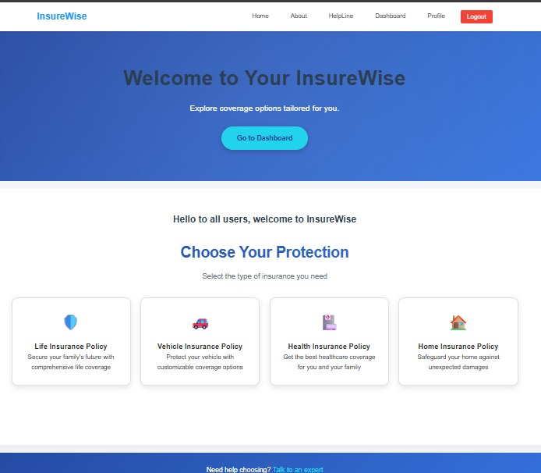
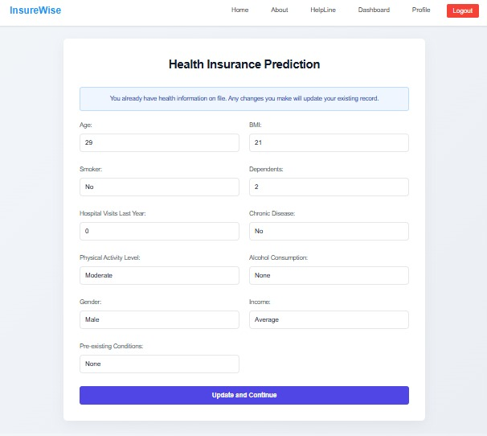
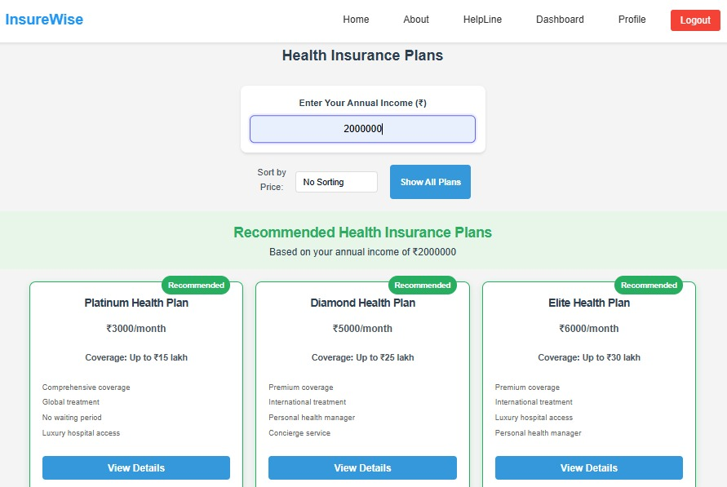
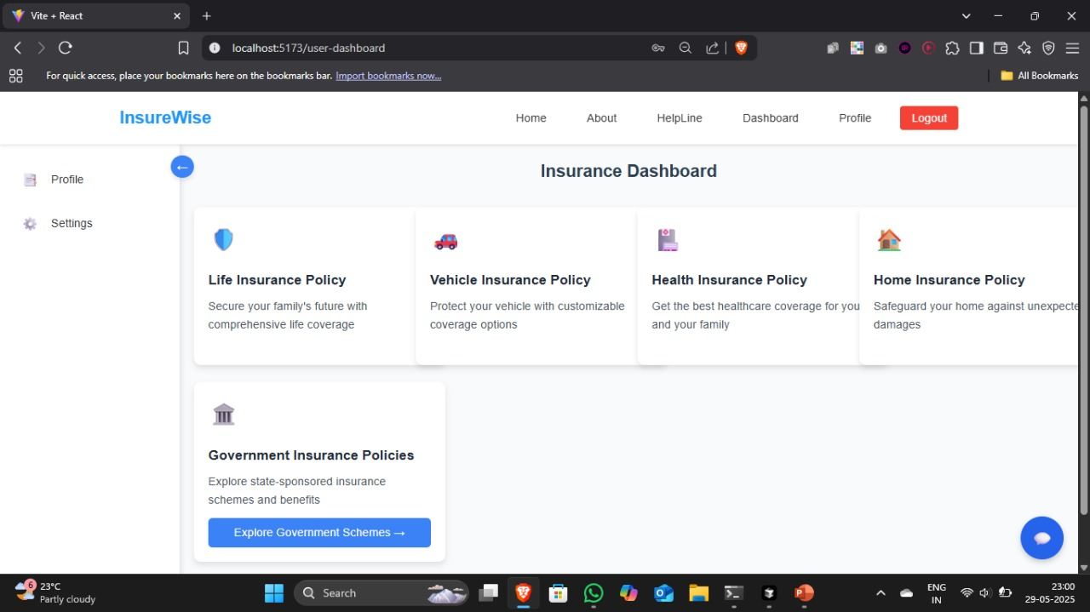
UI/UX(FRONTEND IMAGES)

Slide 11
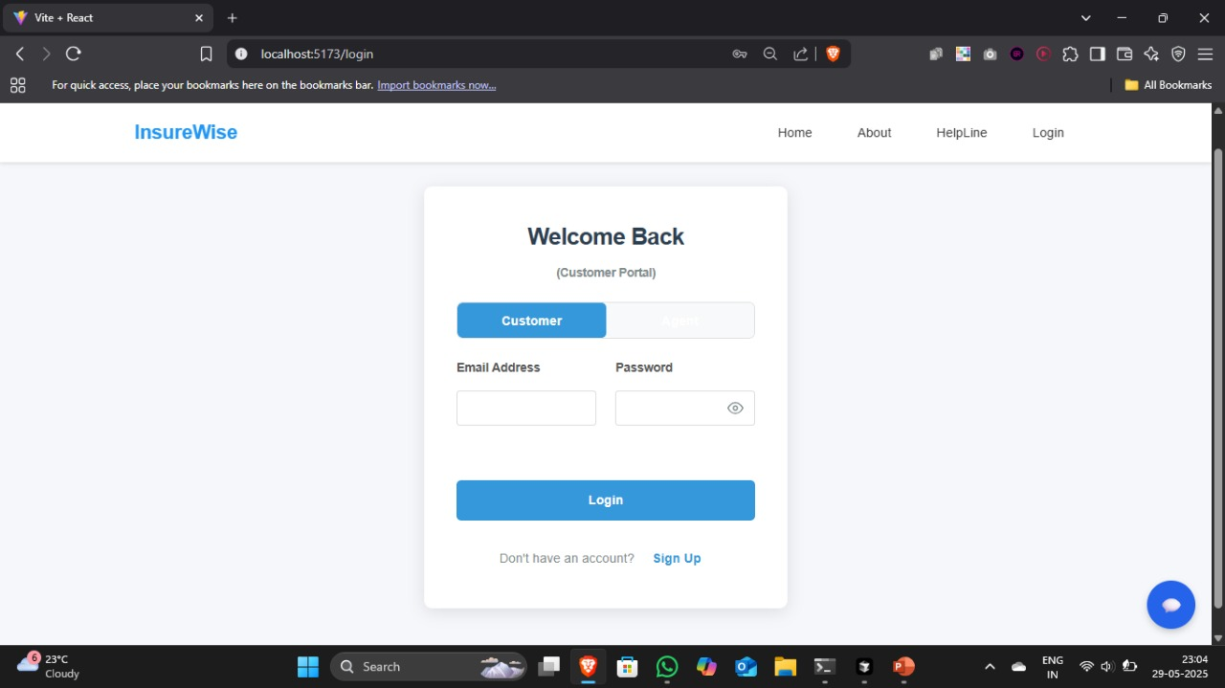
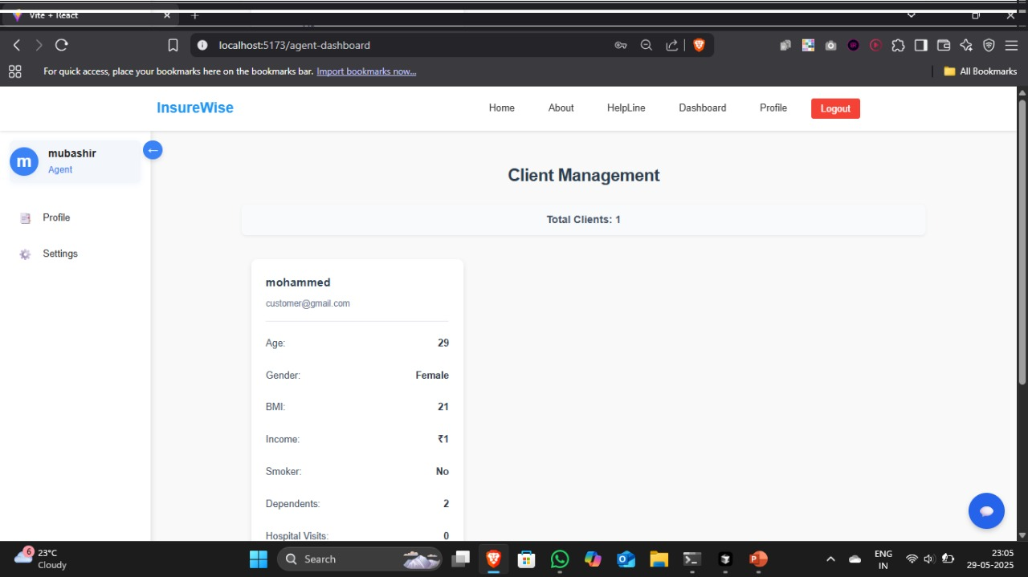

Slide 12
EXPECTED OUTCOME
Behavioral Insights: Agents can view customer insights, risk levels (prominent or not), and feedback.
Automated Risk Evaluation: The system automatically evaluates a customer’s health profile and classifies them as a prominent or non-prominent customer.
Real-time Dashboard: Agents can monitor customer behavior, view predictions, and track analysis of customers.
Secure and Scalable: All data is securely stored using MongoDB, with scalable architecture built using React, Express, and TensorFlow.

Slide 13
Thank you!

